Slide 2

MY TURBAN,MY CROWN
Experiences of European-American having adopted the Sikh faith

Slide 3
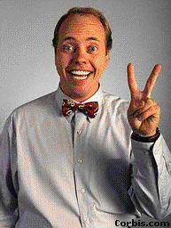
"Sikhs receive their turbans as their inheritance and get them free without paying any price for them.
Some Sikhs, therefore, do not know the value of the turban; they may just throw it away without a second thought.
I was in search of a turban and I found one.
I picked it up, cleaned it and tied it on my head with great honor.
For me it is not a mere piece of cloth which I wrap on my head to cover my hair.
I respect it as a crown granted to me by my ‘father’, Guru Gobind Singh.

Slide 4
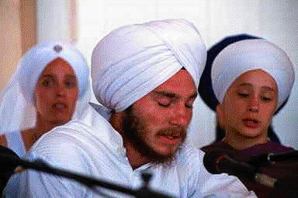
I was not born to Sikh parents.
Therefore, I did not receive this turban free as my heritage.
I had to pay the price for it.
My friends left me when they saw me with a turban on my head.
I had to sacrifice my relations.
Even my mother and brother deserted me because they did not accept me with my turban.
Now you can understand how much I value it.

Slide 5
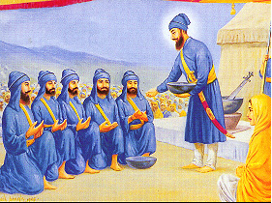
A king puts a crown on his head as the insignia of being the ruler of the country.
Another person with a stronger force may take over his country, and also the crown, from him.
However, nobody can take away my crown from me because it was gifted to me by my father, Guru Gobind Singh.

Slide 6
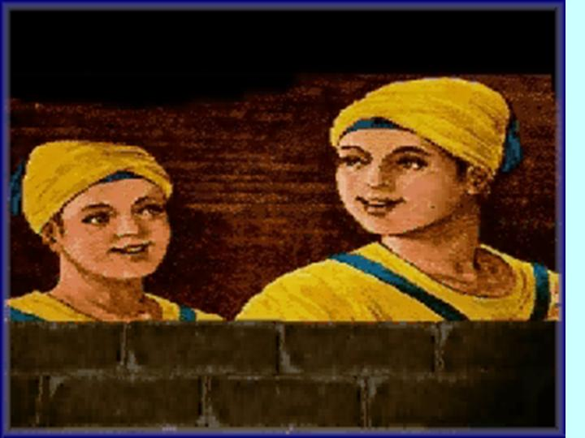
The Guru paid more than the full price of this crown by sacrificing his whole family, his father, his mother and all his four children.
In this way, he earned this crown for his Sikhs.
Later, the Khalsa Panth had to give up their homes and live for three generations in the jungle in order to retain this gift of the Guru on their heads.
Many Sikhs underwent unbearable tortures but did not barter their turban.

Slide 7

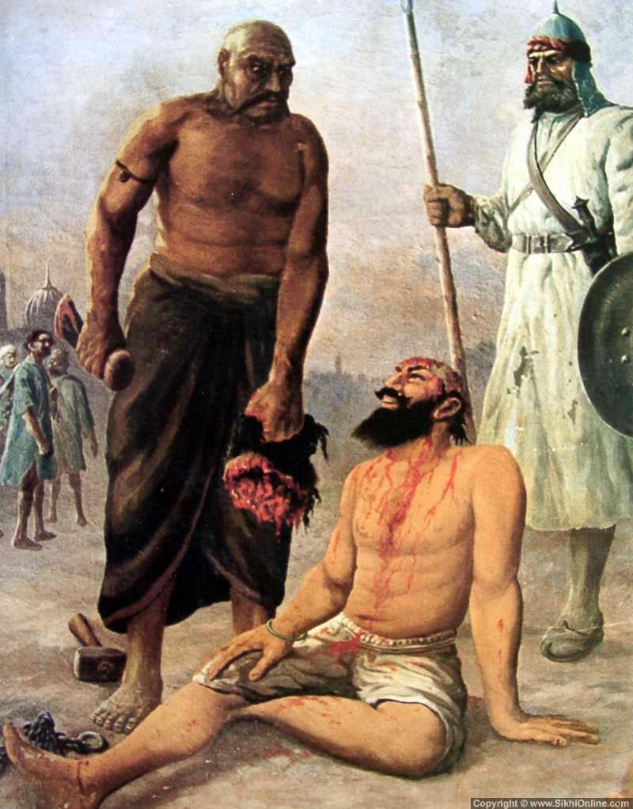
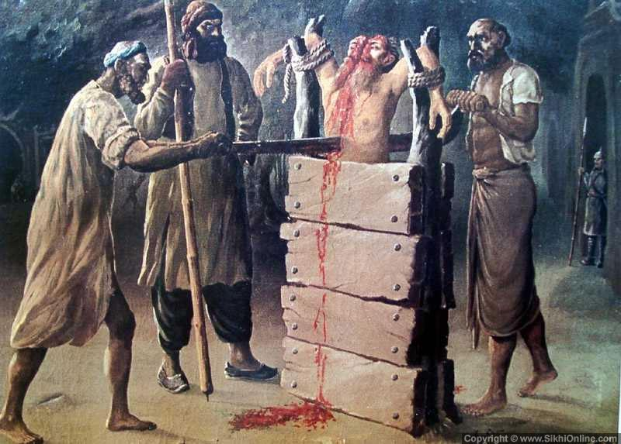
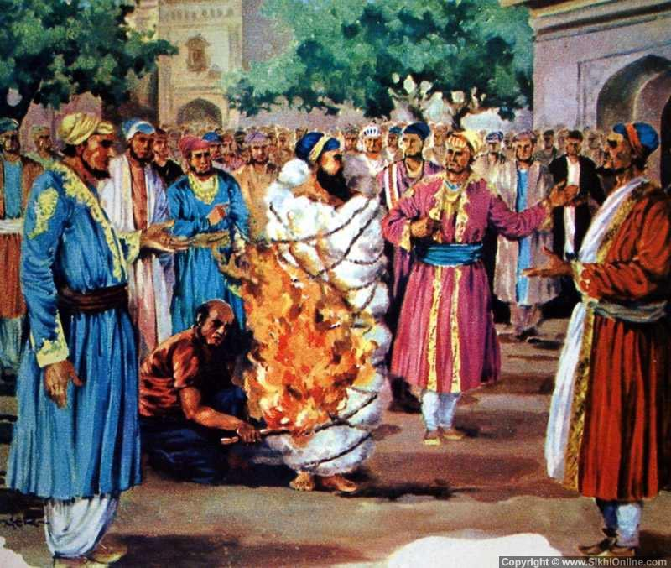
Today, when I wrap my turban on my head, every hair on my body feels grateful to the Guru and utters, "Father, thank you.
You paid the price of this holy crown by the blood of your whole family and your innumerable devotees.
No king or tyrant can take it away from me.
Only ignorant or ungrateful Sikhs may themselves throw it away.
They forget that along with the turban they also lose their right to be respected and addressed as Sardar Ji, the son of Guru Gobind Singh."
MARTYRS

Slide 8
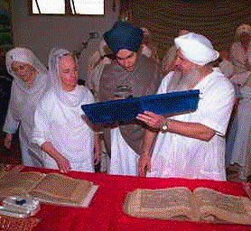
It will not be out of place, to restate here the feelings of another Englishman, Mr. Cliff R. Huthins, who had adopted the Sikh faith.
When someone asked him why he had to wear long hair to practice the Sikh philosophy of life, he answered, "Is it not enough that people call me the son of Guru Gobind Singh just because I wear the five kakaars?"

Slide 9
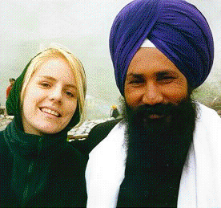
A VOW
"From now onwards I am going to keep my hair and tie my turban to enjoy the self-esteem of being the son of Guru Gobind Singh."

